Slide 1
CS 4350: Fundamentals of Software Engineering CS 5500: Foundations of Software Engineering Lesson 3.2: HTTP Basics
Jon Bell, John Boyland, Mitch Wand
Khoury College of Computer Sciences
© 2021 Jonathan Bell, John Boyland and Mitch Wand. Released under the CC BY-SA license

Slide 2
Learning Objectives for this Lesson
By the end of this lesson you should be able to:
Explain the basic structure of the HTTP protocol
Define the following terms in the context of HTTP:
client, server
request, response
message header
message body
Explain the basic flow of an HTTP request
Explain what is meant by the following:
HTTP is stateless but not sessionless

Slide 3
What is HTTP?
HTTP stands for "HyperText Transfer Protocol"
Originally developed (1989-1991) by Tim Berners-Lee as a protocol for transmitting web pages.
Has evolved into a general-purpose character-based protocol for communicating on the web.

Slide 4
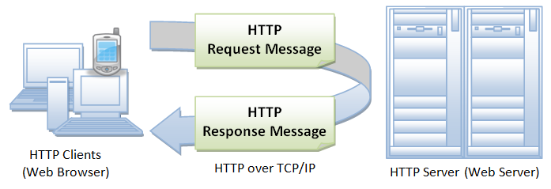
HTTP is Asymmetric
It distinguishes between client and server.
The client initiates a request, and the server replies by sending a response.
https://www3.ntu.edu.sg/home/ehchua/programming/webprogramming/HTTP_Basics.html

Slide 5
HTTP is Stateless
Each request/response pair is independent.
If the client intends the request to be part of a session, then the request must include all of the data needed to allow the server to resume the session at that point.
we'll see later how this data can be included in the request.
We say "Http is stateless but not sessionless"

Slide 6
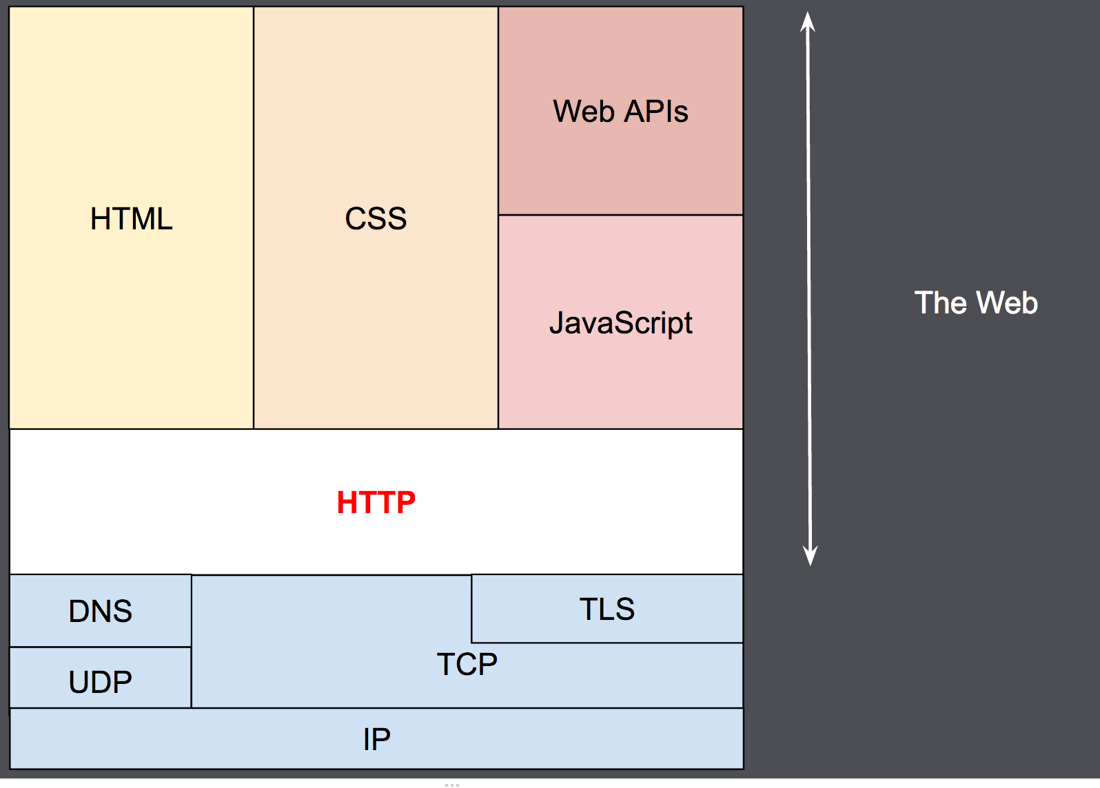
HTTP is an Application-Level Protocol
Usually sits on top of TCP/IP, but other transport layers are possible.
https://developer.mozilla.org/en-us/docs/Web/HTTP/Overview

Slide 7
HTTP is an Application-Level Protocol
Originally designed for transmitting HTML data, but can be used for almost anything.
It's up to the client and the server to decide on what the data is and how it is to be interpreted
The interpretation may be arbitrarily complex, but we'll learn about a useful class of simple protocols, called REST.
Remember Design Principle #2: Define Your Data!

Slide 8
HTTP is Extensible
A request comes with headers, which define the kind of data the client is sending and the kind of data it expects (or is willing to) receive.
Similarly, a response comes with headers, which indicate whether the request was successful or not, and the format or formats in which the reply data is transmitted.
Headers may also include many other kinds of metadata.
The set of possible headers has grown tremendously over the years.
Oops! The version in the video says "server". It's the client who sends the request, of course.

Slide 9
HTTP Flow Step 1: Client opens a TCP Connection
This is the connection over which data will flow
Client can create a fresh connection or re-use an existing one.

Slide 10
HTTP Step 2: Client sends a Request
Consists of:
a method
one of a few simple verbs
a path
a URL
a version
headers
maybe a body
separated from the headers by a blank line
GET /docs/index.html HTTP/1.1
Host: www.nowhere123.com
Accept: image/gif, image/jpeg, */*
Accept-Language: en-us
Accept-Encoding: gzip, deflate
User-Agent: Mozilla/4.0 (compatible; MSIE 6.0; Windows NT 5.1)
(blank line)
https://www3.ntu.edu.sg/home/ehchua/programming/webprogramming/HTTP_Basics.html

Slide 11
HTTP Methods (Verbs)
Each request comes with a method.
There are just a few of these. Here are the ones that you should know:
GET: requests a representation of a resource
the path is the name of the resource
POST: requests the server to create a resource
the path is the name of the resource
there are several ways in which the value of the new resource can be transmitted (more later)
PUT: requests the server to change the value of the resource to the given value
DELETE: requests the server to delete the resource
GET is what a browser does.

Slide 12
HTTP Step 3: Server interprets the Request
GET /docs/index.html HTTP/1.1
Host: www.nowhere123.com
Accept: image/gif, image/jpeg, */*
Accept-Language: en-us
Accept-Encoding: gzip, deflate
User-Agent: Mozilla/4.0 (compatible; MSIE 6.0; Windows NT 5.1)
(blank line)
This request probably started out as http://www.nowhere123.com/docs/index.html
www.nowhere123.com identifies the host (the server's location)
the rest of the request is the path, here /docs/index.html
this might be a path in the server's file system,
OR it could be anything at all—
it's entirely up to the server to interpret the path
We'll see later how these paths are interpreted in REST protocols.

Slide 13
HTTP Step 4: Server sends a Response
Consists of
a version
a status code
a status message
some headers
maybe a body
HTTP/1.1 200 OK
Date: Sat, 09 Oct 2010 14:28:02 GMT
Server: Apache
Last-Modified: Tue, 01 Dec 2009 20:18:22 GMT
ETag: "51142bc1-7449-479b075b2891b"
Accept-Ranges: bytes
Content-Length: 29769
Content-Type: text/html
<!DOCTYPE html... (here comes the 29769 bytes of the requested web page)
https://developer.mozilla.org/en-us/docs/Web/HTTP/Overview (NOT a response to the preceding request!)

Slide 14
HTTP Step 5: The client closes or reuses the connection

Slide 15
Review: Learning Objectives for this Lesson
You should now be able to:
Explain the basic structure of the HTTP protocol
Define the following terms in the context of HTTP:
client, server
request, response
message header
message body
List the steps in the basic flow of an HTTP request
Explain what is meant by the following:
HTTP is stateless but not sessionless

Slide 16
Next steps...
In the next lesson, we will learn about REST, a philosophy for designing application-level protocols on top of http.

